Slide 1
CookAtlas
Alek Breitenbach, Ethan Twombly, Jack Moore, Josh Lee, Lukyan Sukhachevskyi

Slide 2
Main Idea
Easy Recipe Searching
Save your favorites
Extensive tags
Find recipes that match your ingredients and skill level
Bookmark recipes you want to save or revisit
Tags to filter your search by whatever criteria you want

Slide 3
Additional Features
Social element
Shopping list
Meal Planner
Rate recipes, and certain users can review and upload their own
Select recipes to generate an ingredient shopping list
Generate a meal plan based on their dietary preferences, available ingredients, and schedule

Slide 4
Tech stack
backend
frontend
Database
Node.js / Express
React
Postgresql
authentication
Bcrypt

Slide 5
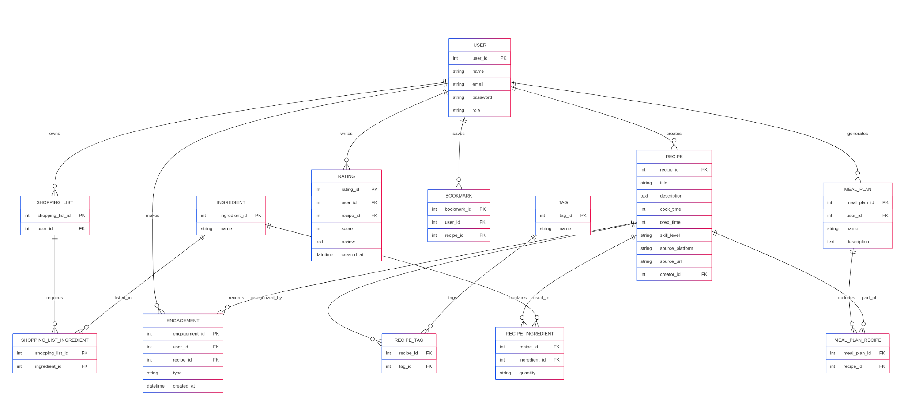
ER Diagram

Slide 6
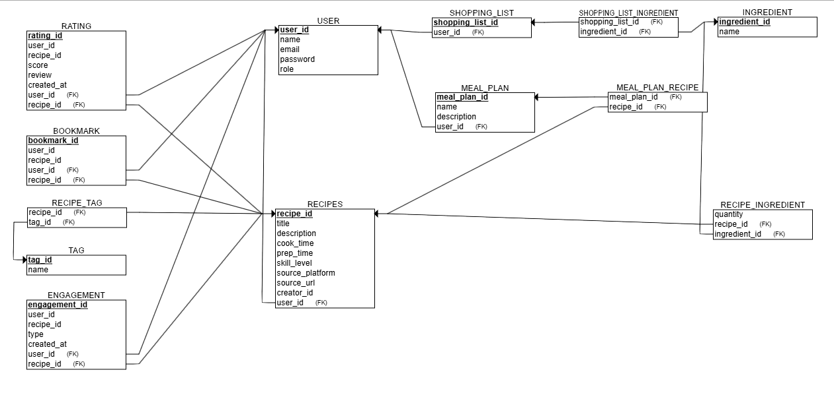
Relational Schema

Slide 7
Live Demo

